Slide 1
Use a pipeline for deploy a Kubernetes Cluster
12 ottobre 2022

Slide 2
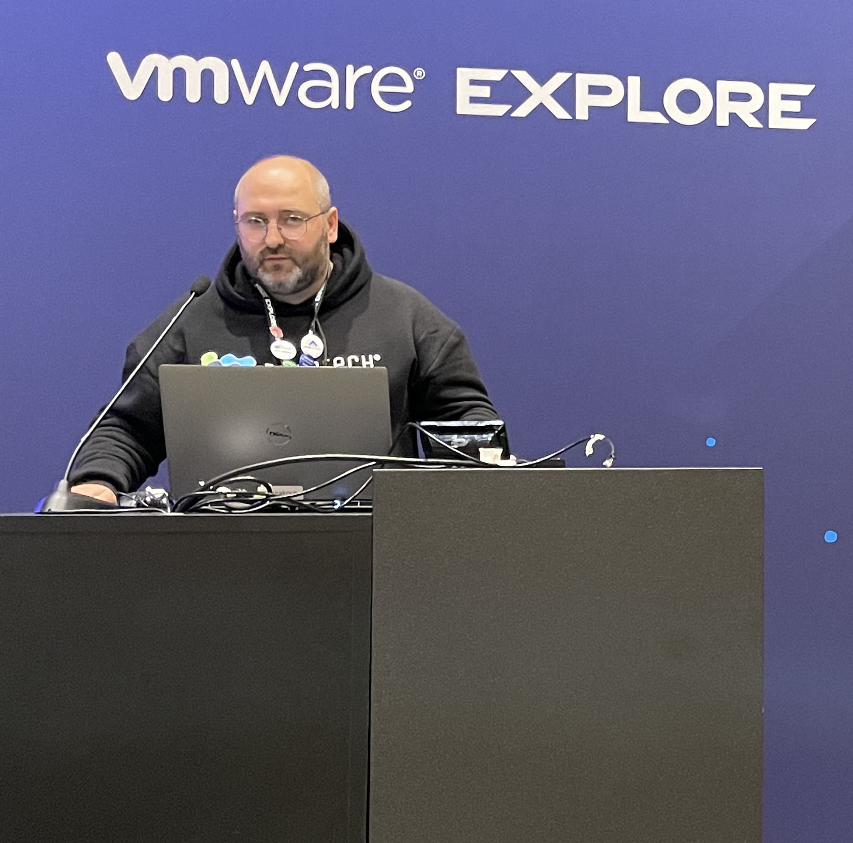
Nicola marco decandia
VMware PSO Consulting Architect
VMware Certified Instructor
vExpert 2022
The Linux Foundation Authorized Trainer for Kubernetes
AWS Champion Authorized Instructor
Google Cloud Platform Authorized Instructor
SUSE Certified Instructor
CEO DESOTECH

Slide 3
Introduzione a Aria Automation
Code Stream
Code Assembly
Service Broker
Demo

Slide 4

Simple, one-button operation, fully automatic creation of a TKGS cluster

Slide 5
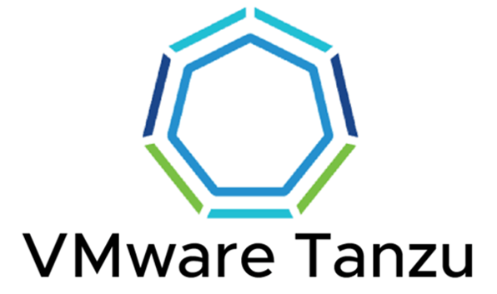

Slide 6
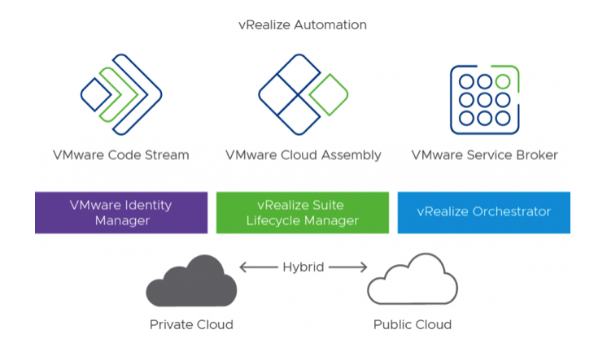
Aria Automation

Slide 7
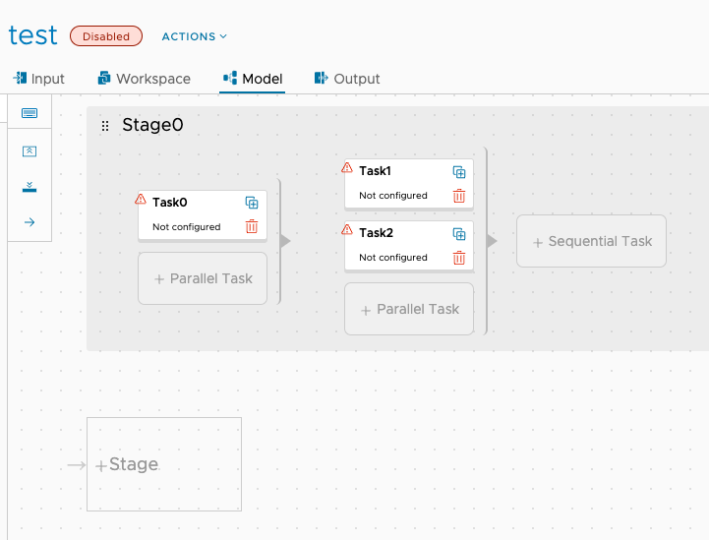

Code Stream 1/2

Slide 8
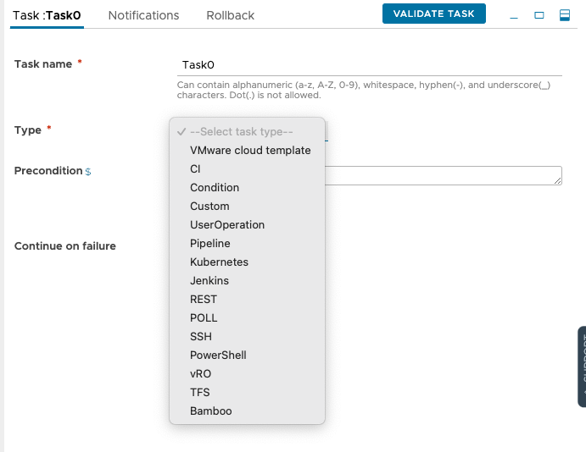
Code Stream 2/2

Slide 9
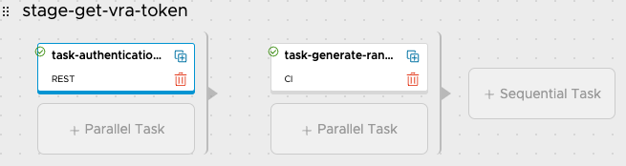
Code Stream – prerequisites
1
VRA Authentication with Bearer Token
2
Generate random string for namespace and tanzu cluster
1
2

Slide 10
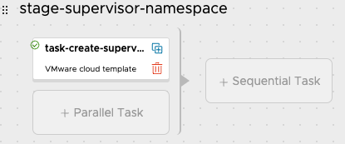
Code Stream – create the namespace
1
Create a Namespace running a Cloud Assembly Template
1

Slide 11
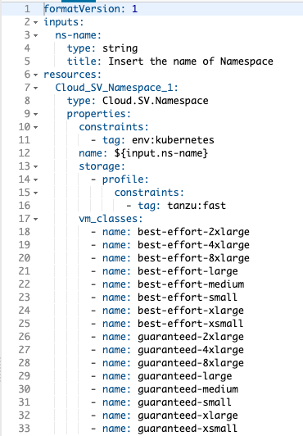

Cloud Assembly Create Namespace

Slide 12
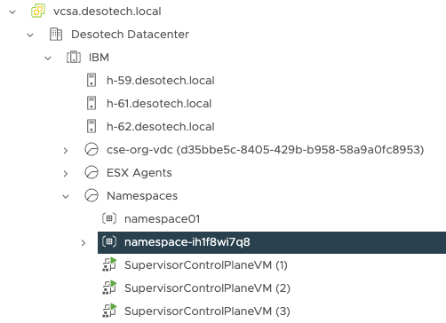
vCenter Namespace

Slide 13
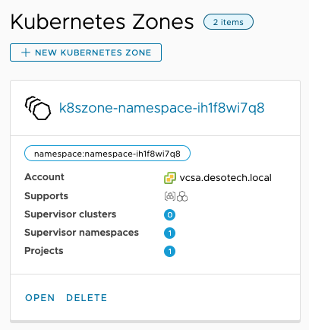
If you want to deploy TKGS cluster inside a custom namespace, you must have a Kubernetes Zone created, tagged and connected to the project.

Slide 14
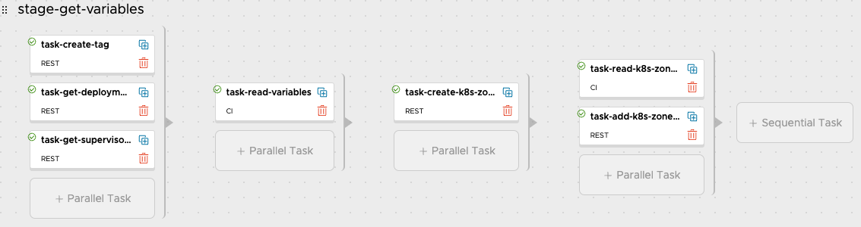
Code Stream – Creation of Kubernetes Zone in vRA

Slide 15
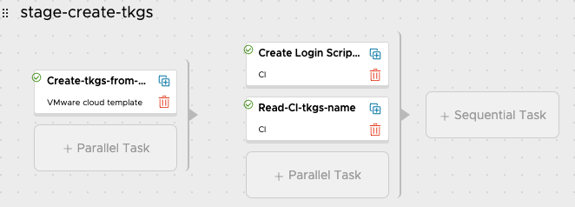
Code Stream – create the TKGS cluster

Slide 16
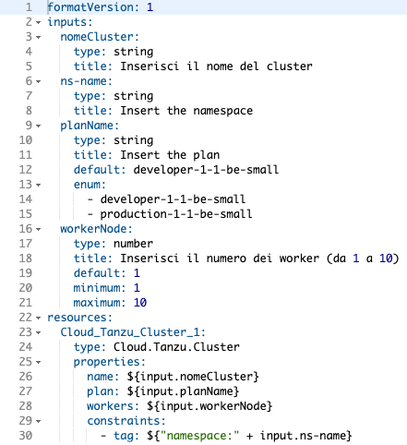
Cloud Assembly Create Cluster

Slide 17
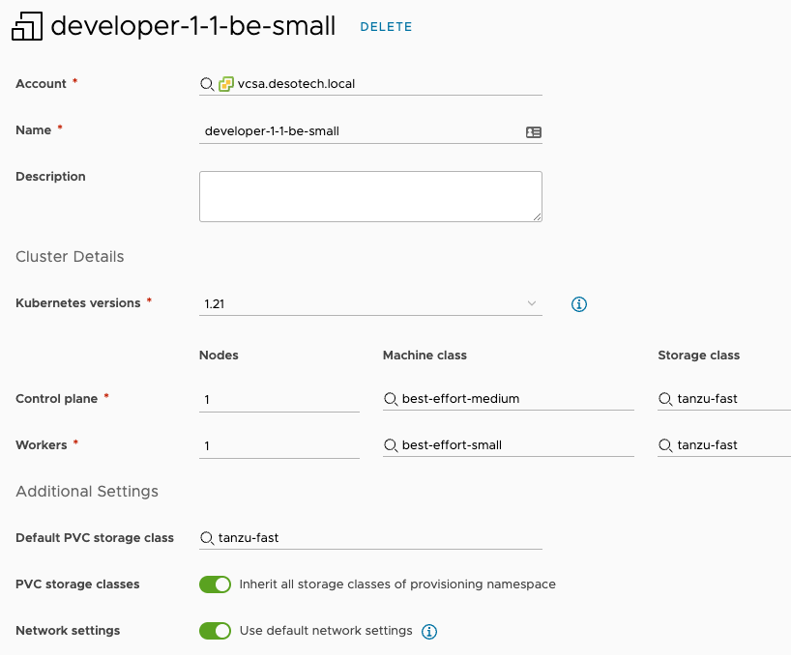
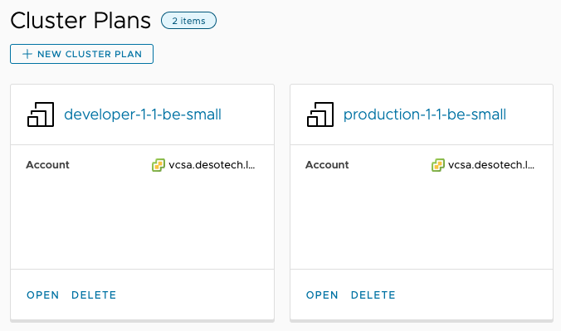
Cluster Plans

Slide 18
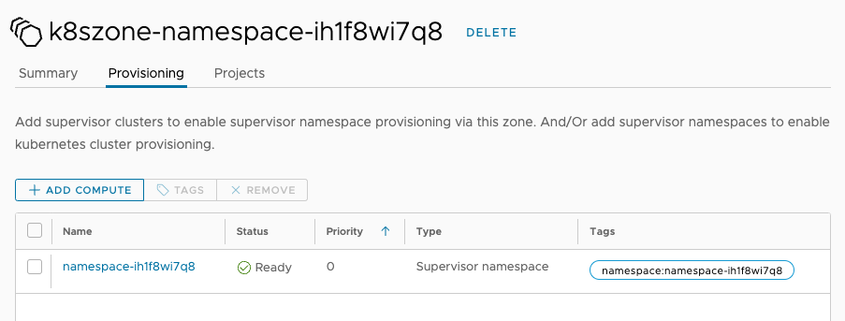
Kubernetes Zone

Slide 19
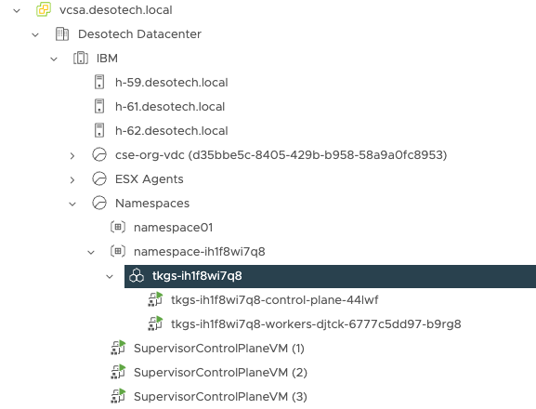
TKGs on vCenter

Slide 20
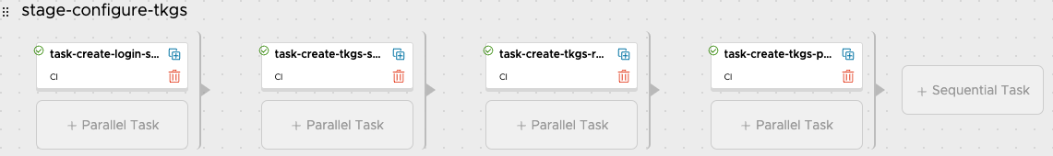
Code Stream – script post installation
1
3
Download the kubeconfig for access to the tkgs cluster
Create a Kubernetes ClusterRoleBinding
2
Create a Kubernetes Service Account and export the Token
4
Remove the deprecated PSP
1
2
3
4

Slide 21
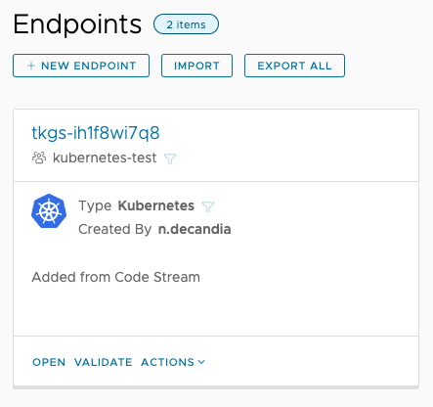
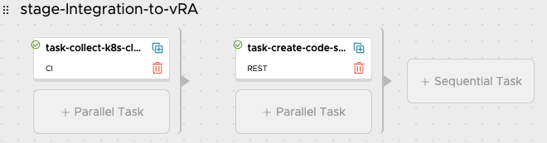
Code Stream – integration with vRA
1
Collect Kubeconfig informations
2
Add a CodeStream Endpoints
1
2

Slide 22
DEMO

Slide 24
THANK YOU

